Slide 1






Career Aspirations
of Gen Z
Presented By: Vaishnavi Kenjale

Slide 2



Problem Statement
Employers in India need detailed insights into the career aspirations and preferences of their workforce, especially considering gender differences and key influencing factors. This analysis aims to provide a clear understanding of these aspects to help organizations better attract, retain, and support their employees.

Slide 3




Objective
To analyze the career aspirations of respondents from India, focusing on gender differences, key influences, and preferences. This includes examining factors like interest in education abroad, socially impactful companies, salary expectations, remote working preferences, and work frustrations.

Slide 4


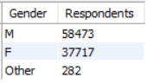
1. What is the gender distribution of respondents from India?
SELECT
Gender,
COUNT(*) AS Respondents
FROM genz
where Country = 'IND'
GROUP BY Gender;

Slide 5


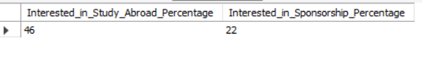
2. What percentage of respondents from India are interested in education abroad and sponsorship?
SELECT
ROUND(COUNT(CASE WHEN `Study Abroad` = 'Yes' THEN 1 END) * 100 / COUNT(*),0) AS
Interested_in_Study_Abroad_Percentage,
ROUND(COUNT(CASE WHEN `Study Abroad` = 'Subsidized' THEN 1 END) * 100 / COUNT(*),0) AS
Interested_in_Sponsorship_Percentage
FROM genz
WHERE Country = 'IND';

Slide 6
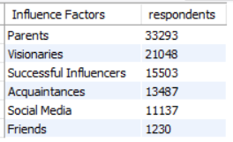


3. What are the 6 top influences on career aspirations for respondents in India?
SELECT
`Influence Factors`,
COUNT(*) AS respondents
FROM genz
WHERE Country = 'IND'
GROUP BY `Influence Factors`
ORDER BY COUNT(*) DESC
LIMIT 6;

Slide 7
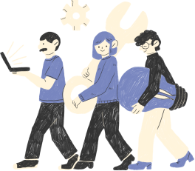
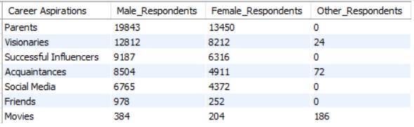
4. How do career aspiration influences vary by gender in India?
SELECT
`Influence Factors` AS `Career Aspirations`,
COUNT(CASE WHEN Gender = 'M' THEN 1 END) AS Male_Respondents,
COUNT(CASE WHEN Gender = 'F' THEN 1 END) AS Female_Respondents,
COUNT(CASE WHEN Gender = 'Other' THEN 1 END) AS Other_Respondents
FROM genz
WHERE Country = 'IND'
GROUP BY `Influence Factors`
ORDER BY Male_Respondents DESC,Female_Respondents DESC, Other_Respondents DESC;

Slide 8

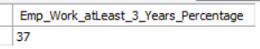
5. What percentage of respondents are willing to work for a company for at least 3 years?
SELECT
ROUND(SUM(CASE WHEN `Employer for 3 years` = 'Yes' THEN 1 END) * 100 / COUNT(*),0) AS
Emp_Work_atLeast_3_Years_Percentage
FROM genz;

Slide 9
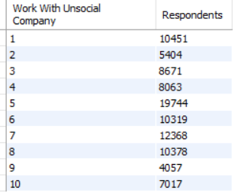

6. How many respondents prefer to work for socially impactful companies?
SELECT
`Work With Unsocial Company`,
COUNT(*) Respondents
FROM genz
WHERE Country = 'IND'
GROUP BY `Work With Unsocial Company`
ORDER BY `Work With Unsocial Company`;

Slide 10

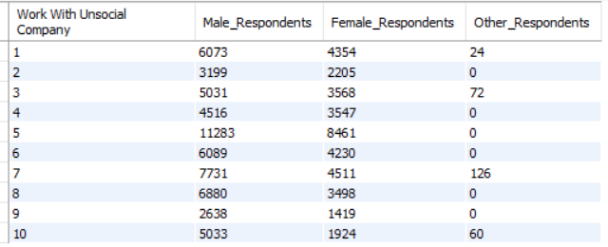
7. How does the preference for socially impactful companies vary by gender?
SELECT
`Work With Unsocial Company`,
COUNT(CASE WHEN Gender = 'M' THEN 1 END) AS Male_Respondents,
COUNT(CASE WHEN Gender = 'F' THEN 1 END) AS Female_Respondents,
COUNT(CASE WHEN Gender = 'Other' THEN 1 END) AS Other_Respondents
FROM genz
WHERE Country = 'IND'
GROUP BY `Work With Unsocial Company`
ORDER BY `Work With Unsocial Company`;

Slide 11


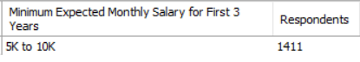
8. What is the distribution of minimum expected salary in the first three years among respondents?
SELECT
`Expected Monthly Salary for First 3 Years` AS `Minimum Expected Monthly Salary for First 3 Years`,
COUNT(*) AS Respondents
FROM genz
WHERE Country = 'IND'
GROUP BY `Expected Monthly Salary for First 3 Years`
ORDER BY Respondents ASC
LIMIT 1;

Slide 12

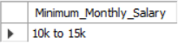
9. What is the expected minimum monthly salary in hand?
SELECT
MIN(`Fresher Monthly Salary`) AS Minimum_Monthly_Salary
FROM genz
WHERE Country = 'IND' AND `Fresher Monthly Salary`<> 0;

Slide 13
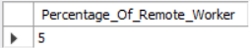

10. What percentage of respondents prefer remote working?
SELECT
ROUND(SUM(CASE WHEN `Working Environment` = 'Remote' THEN 1 END)*100/COUNT(*)) AS Percentage_Of_Remote_Worker
FROM genz
WHERE Country = 'IND';

Slide 14

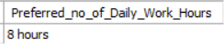

11. What is the preferred number of daily work hours?
SELECT
MAX(`Working Hours EveryDay`) AS Preferred_no_of_Daily_Work_Hours
FROM genz;

Slide 15
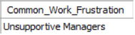

12. What are the common work frustrations among respondents?
SELECT
MAX(`Frustration at work`) AS Common_Work_Frustration
FROM genz
WHERE Country = 'IND';

Slide 16

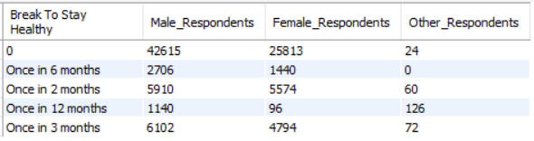
13. How does the need for work-life balance interventions vary by gender?
SELECT
`Break To Stay Healthy`,
COUNT(CASE WHEN Gender = 'M' THEN 1 END) AS 'Male_Respondents',
COUNT(CASE WHEN Gender = 'F' THEN 1 END) AS 'Female_Respondents',
COUNT(CASE WHEN Gender = 'Other' THEN 1 END) AS 'Other_Respondents'
FROM genz
WHERE Country = 'IND'
GROUP BY `Break To Stay Healthy`
ORDER BY 'Male_Respondents', 'Female_Respondents', 'Other_Respondents';

Slide 17

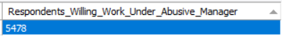
14. How many respondents are willing to work under an abusive manager?
SELECT
COUNT(`Work at Unhealthy Workspace`) AS Respondents_Willing_Work_Under_Abusive_Manager
FROM genz
WHERE Country = 'IND' AND `Work at Unhealthy Workspace` = 'Yes';

Slide 18
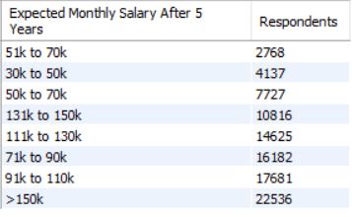

15. What is the distribution of minimum expected salary after five years?
SELECT
`Expected Monthly Salary After 5 Years`,
COUNT(*) AS Respondents
FROM genz
WHERE Country = 'IND'
GROUP BY `Expected Monthly Salary After 5 Years`
ORDER BY Respondents ASC;

Slide 19
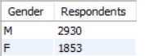

16. What are the remote working preferences by gender?
SELECT
Gender,
COUNT(*) AS Respondents
FROM genz
WHERE Country = 'IND' AND `Working Environment`= 'Remote'
GROUP BY Gender;

Slide 20

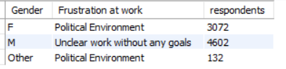
17. What are the top work frustrations for each gender?
WITH cte AS(
SELECT
Gender,
`Frustration at work` ,
COUNT(*) AS respondents,
ROW_NUMBER() OVER (PARTITION BY Gender ORDER BY COUNT(*) DESC) AS row_num
FROM genz
WHERE `Frustration at work` IS NOT NULL AND Country = 'Ind'
GROUP BY Gender, `Frustration at work`
ORDER BY Gender )
SELECT
Gender,
`Frustration at work` ,
respondents
FROM cte
WHERE row_num=1;

Slide 21

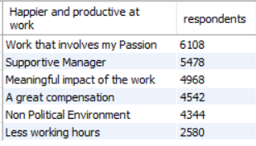

18. What factors boost work happiness and productivity for respondents?
SELECT
`Happier and productive at work`,
COUNT(*) AS respondents
FROM genz
WHERE Country = 'IND' AND `Happier and productive at work` IS NOT NULL
GROUP BY `Happier and productive at work`
ORDER BY respondents DESC;

Slide 22

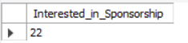
19. What percentage of respondents need sponsorship for education abroad?
SELECT
ROUND(COUNT(CASE WHEN `Study Abroad` = 'Subsidized' THEN 1 END) * 100.0 / COUNT(*),0) AS Interested_in_Sponsorship
FROM genz
WHERE Country = 'IND';

Slide 23




Conclusion
This analysis provides a comprehensive understanding of the career aspirations and preferences of respondents from India, highlighting significant gender differences and key influencing factors. It reveals the importance of education abroad, socially impactful work, and remote working options among the workforce. Additionally, it underscores the need for competitive salaries, work-life balance interventions, and addressing common work frustrations to boost job satisfaction and productivity. These insights can guide employers and policymakers in creating supportive environments that align with the aspirations and needs of the diverse workforce in India.

Slide 24




Thank You

